Slide 1
Professor Recommendation Service
LastLap
김현진 송민석 장민석 조재희
2024.09.20

Slide 2
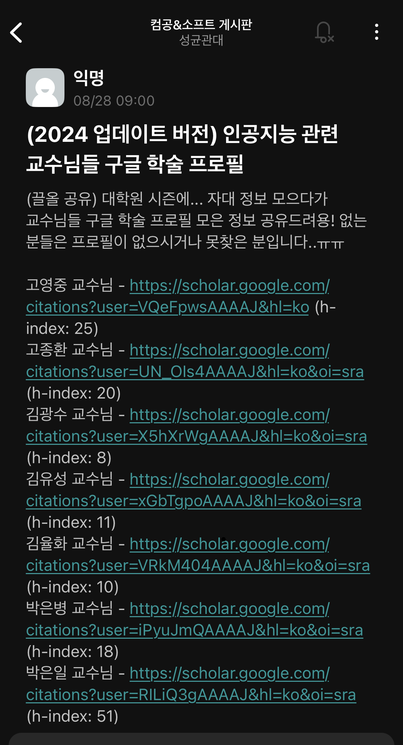
1. Motivation
The problem is..
There is no well-organized website
about professors’ profiles.
Students are suffering from searching labs!
24-Fall Capstone Design Project

Slide 3


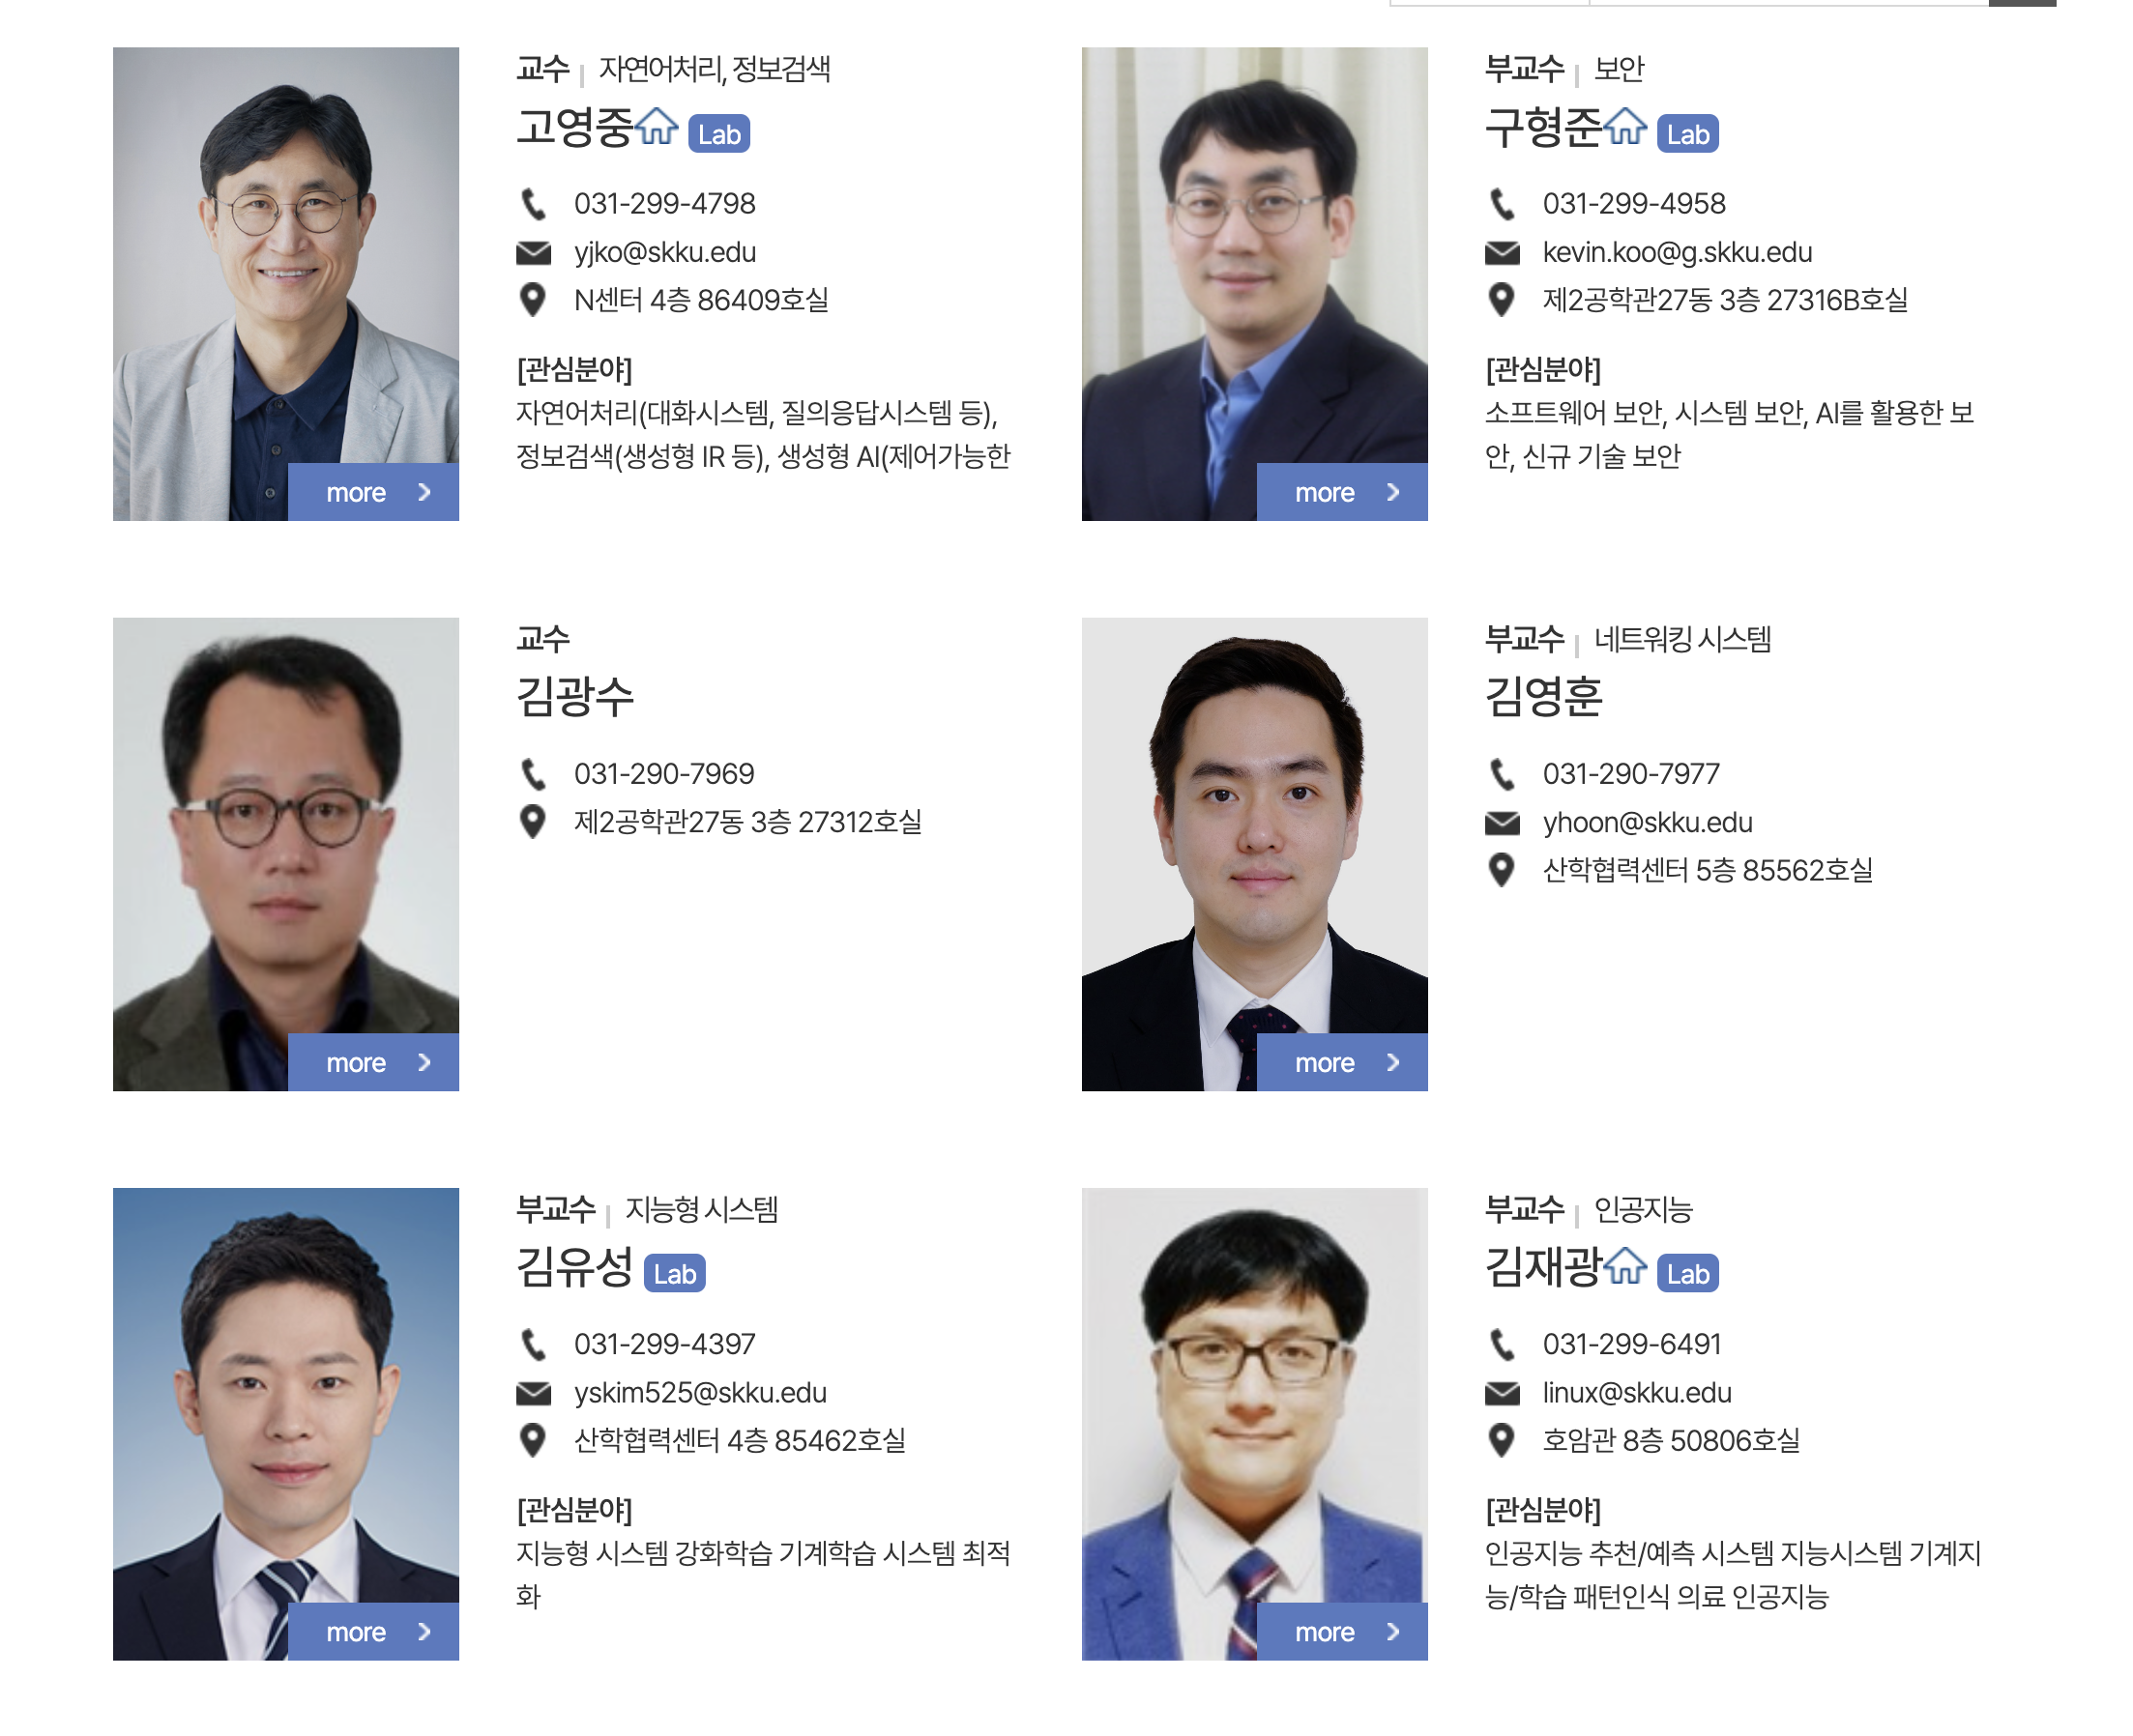
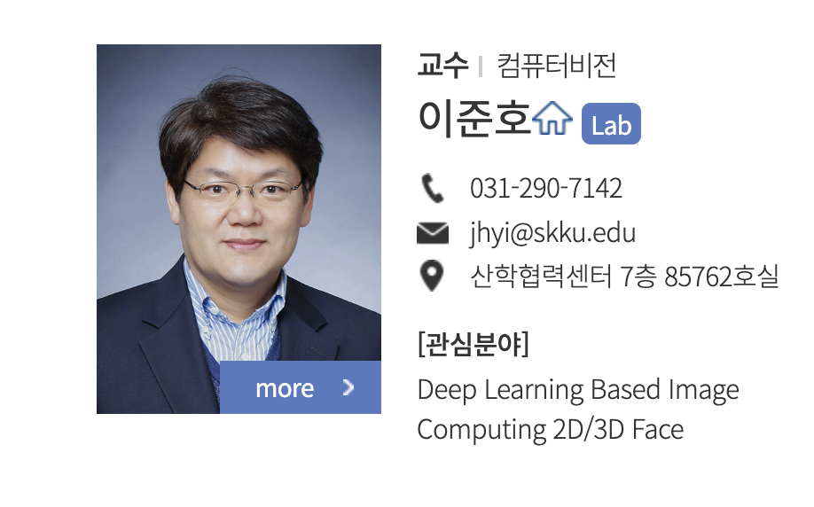

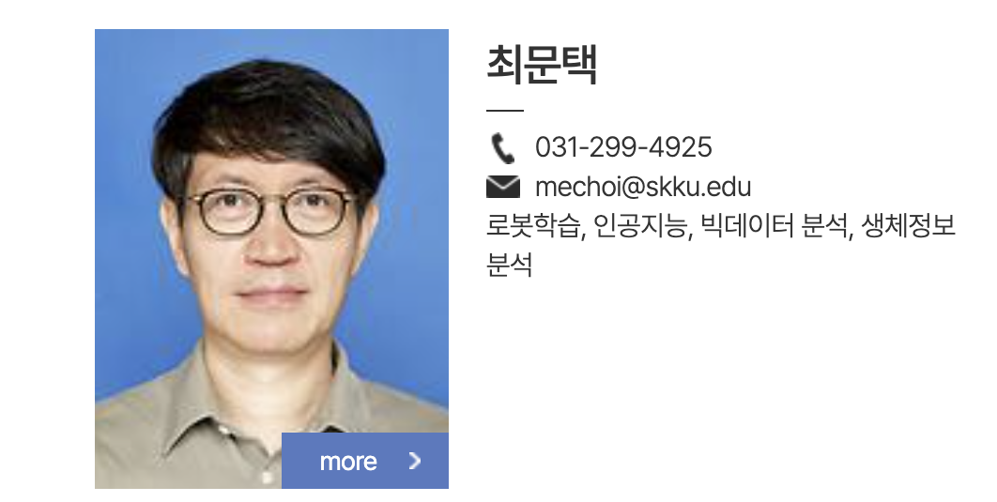
1. Motivation
For example..
I’m trying to find AI professor, so I search SW department professor,,,
I couldn’t get to know details only with areas of interest and someone has nothing
Some professors are not in SW but in others.
.
+α
!!!! nothing
24-Fall Capstone Design Project

Slide 4
2. Expected Outcomes
“
“
A Professor Recommendation Service
Based on Natural Language Processing Models
Expected Outcomes
Reduced effort for professors in student recruitment
Broader access to professors conducting research in areas of interest beyond one's own department
Ability to explore detailed subfields beyond the major field of study
24-Fall Capstone Design Project

Slide 5
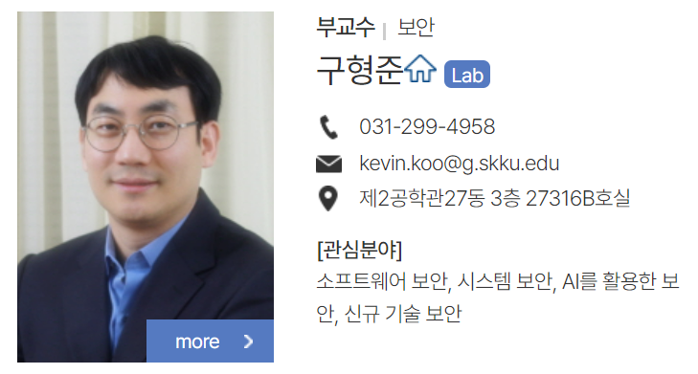


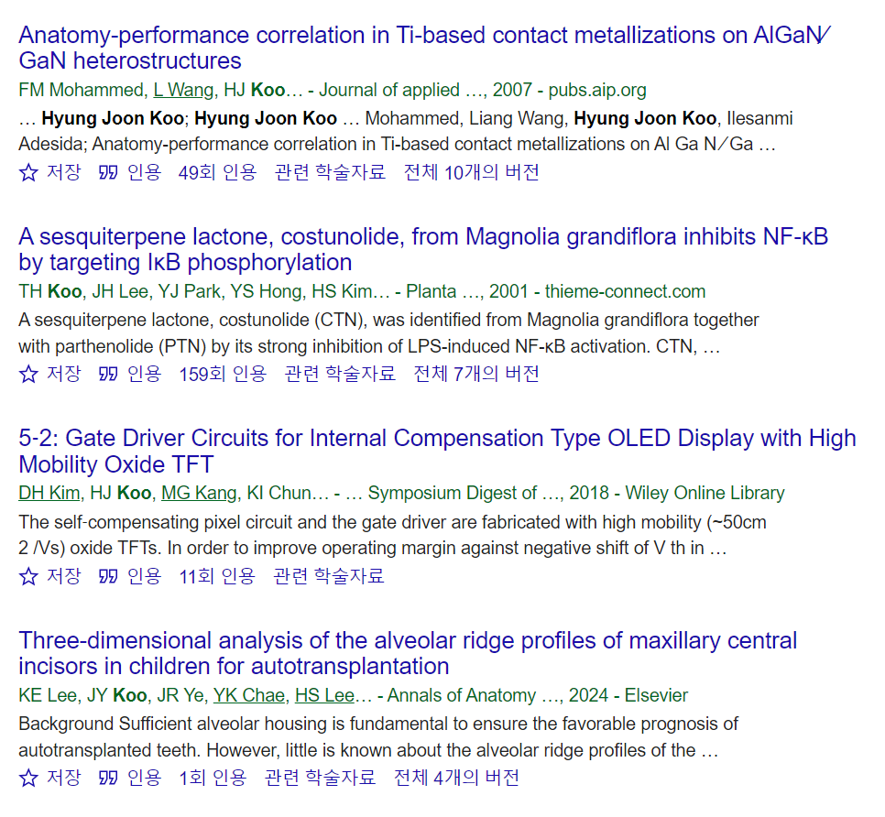

3. Functions and expected related technologies
Functions
Security
Recommended Results
Expected related technologies
Text Embedding (BERT, Word2Vec)
Web Crawling (BeautifulSoup)
Recommendation System (Content Based Filtering, Similarity Search)
24-Fall Capstone Design Project

Slide 6


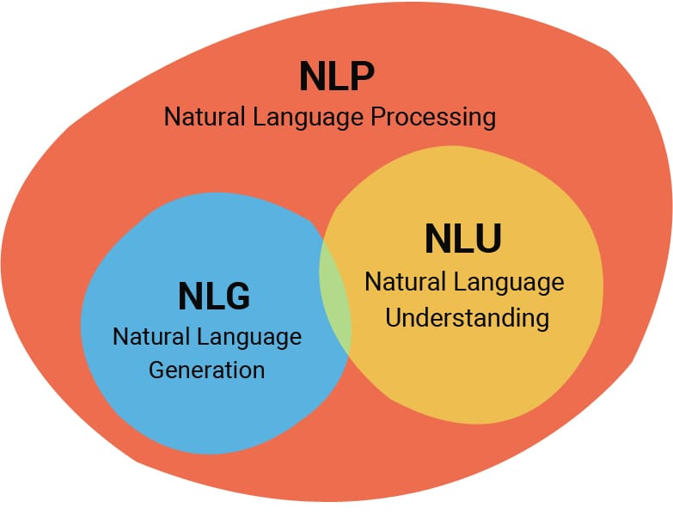
4. Role Allocation
Web design and frontend development
Backend and database design
Crawling and AI modeling design
24-Fall Capstone Design Project

